Slide 1

CS Fundamentals Series
crystal@adadevelopersacademy.org

Slide 2



Slide 3
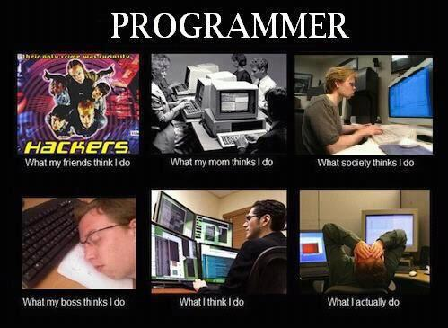

Slide 4
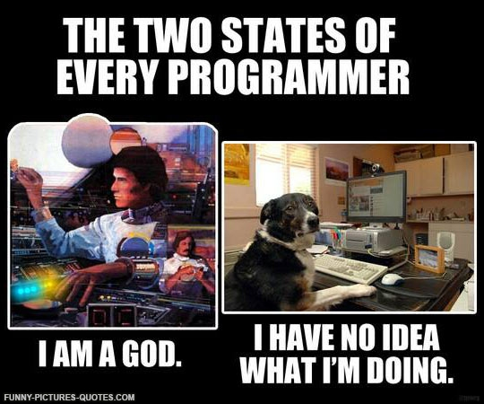

Slide 5
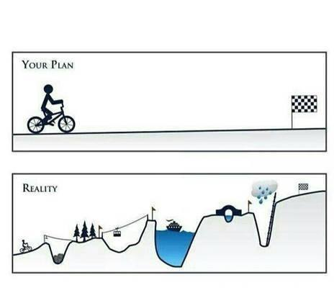

Slide 6
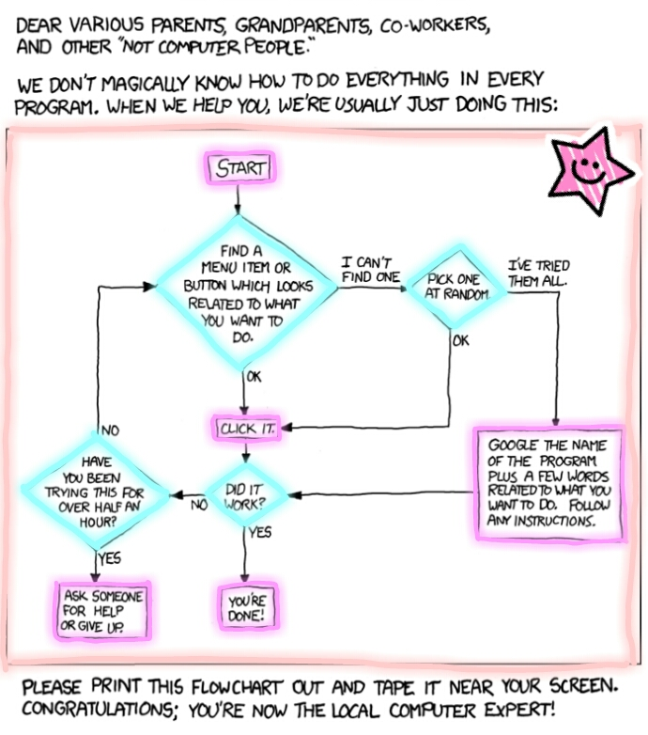

Slide 7

How to become a programmer, or the art of Googling well
“Sometimes it took hours for me to figure the simplest things out, but I’d come to understand that the answer was out there, somewhere.”
“But most importantly, I know that experience, though important, is not everything. The gap is not insurmountable because I have what it takes to learn.”

Slide 8
“The barriers to becoming a software engineer are real. People born in technical families, or who were introduced to programming at an early age have this easy confidence that lets them tackle new things, to keep learning — and, in our eyes, they just keep getting further and further ahead. Last year, I saw this gap and gave up. But all we really need is the opportunity to see that it’s not hopeless. It’s not about what we already know, it’s about how we learn. It’s about the tenacity of sitting in front of a computer and googling until you find the right answer. It’s about staring at every line of code until you understand what’s going on, or googling until you do. It’s about googling how-to, examples, errors, until it all begins to make sense.”

Slide 9

10,000 Hours of Practice
10,000 hours to achieve mastery in a field
40 hrs/week for 5 years = 10,000 hours

Slide 10
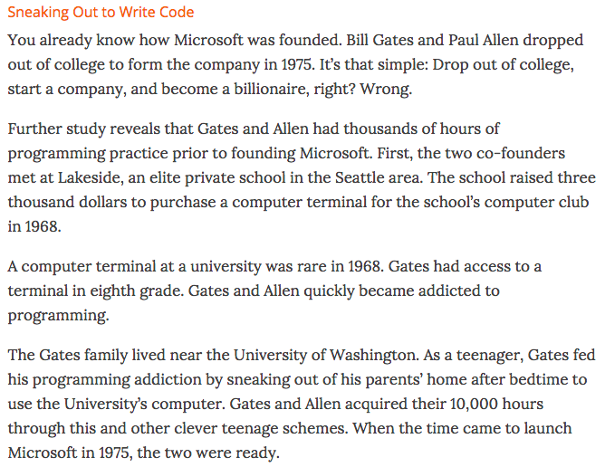

Slide 11

We write a lot of code – even if it’s bad code! It’s practice!
We consult the Internet when we don’t know – Google, Stackoverflow, c/p error messages!
We ask questions – to our teachers, our mentors, our peers, and ourselves!

Slide 12



Slide 13

Ada Lovelace
Grace Hopper
Anita Borg
Alan Turing
Edsger Dijkstra
Donald Knuth
Steve Wozniak

Slide 14
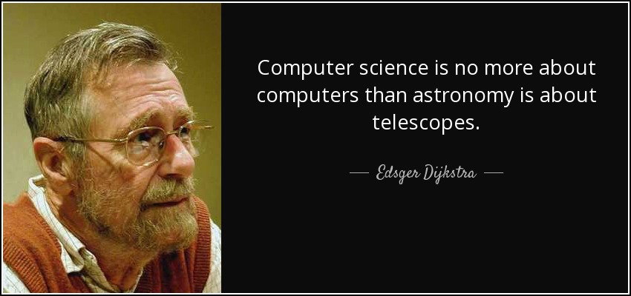

Slide 15

DevOps
Data Science / Big Data
HCI
GIS
Information Science
Computational Linguistics
Security
Data Visualization
Embedded & Real Time Systems

Slide 16

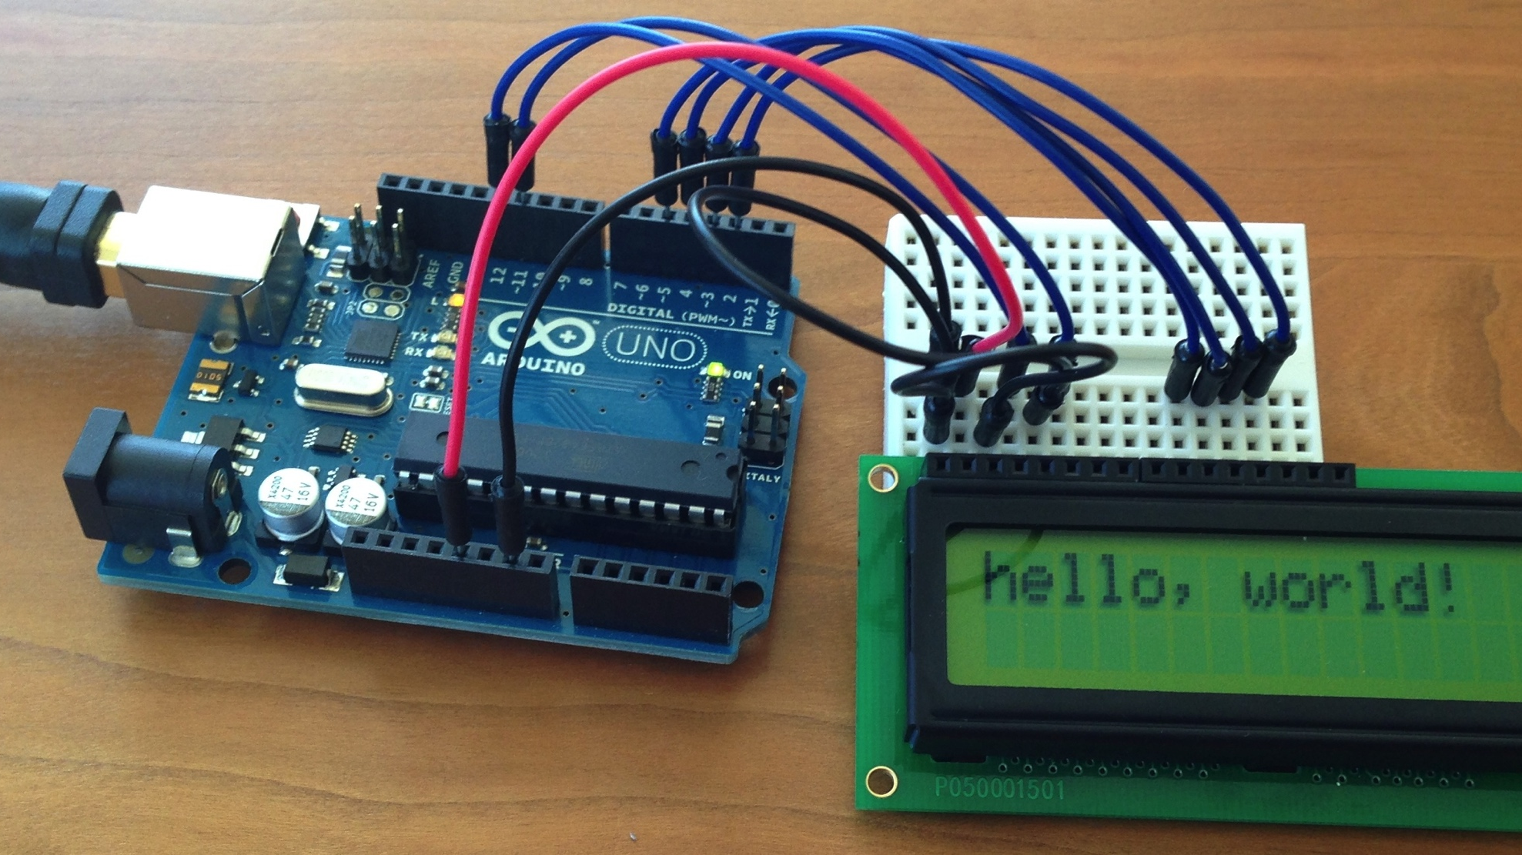

Slide 17




Slide 18

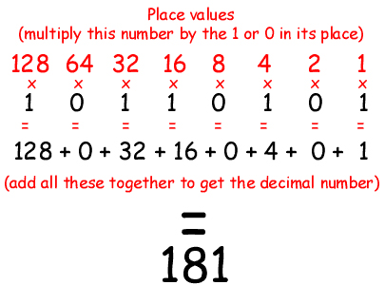

Slide 19

An embedded system
Various uses: http://playground.arduino.cc/Projects/Ideas
We’re going to make a binary counter with 3 LEDs that can count from ____ to ____

